Slide 1
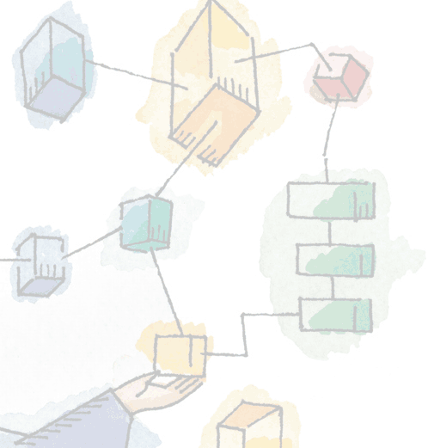
Chapter 8 Virtual Memory

Slide 2
Virtual memory
Virtual memory
Virtual memory is a technique that allows the execution of processes which are not completely available in memory

Slide 3
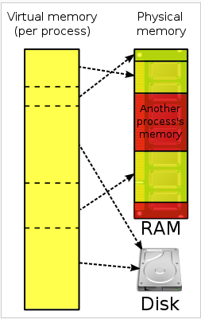
Virtual memory

Slide 4
8.1 HARDWARE AND CONTROL STRUCTURES
Two characteristics of paging and segmentation
1) Memory references are logical addresses dynamically translated into physical addresses at run time
A process may be swapped in and out of main memory occupying different regions at different times during execution
2) A process may be broken up into pieces that do not need to located contiguously in main memory
Notes:
Two characteristics of paging and segmentation are the keys to this breakthrough in memory management:
All memory references within a process are logical addresses that are dynamically translated into physical addresses at run time.
A process may be swapped in and out of main memory occupying different regions of main memory at different times during the course of execution.
2. A process may be broken up into a number of pieces (pages or segments) and these pieces need not be contiguously located in main memory during execution.
The combination of dynamic run-time address translation and the use of a page or segment table permits this.

Slide 5
Breakthrough in Memory Management
If both of those two characteristics are present,
then it is not necessary that all of the pages or all of the segments of a process be in main memory during execution.
If the next instruction, and the next data location are in memory then execution can proceed
at least for a time
Notes:
If the piece (segment or page) that holds the next instruction to be fetched and the piece that holds the next data location to be accessed are in main memory,
then execution may proceed (at least for a time).

Slide 6
Execution of a Process
Operating system brings into main memory a few pieces of the program
Resident set - portion of process that is in main memory
An interrupt is generated when an address is needed that is not in main memory
Operating system places the process in a blocking state
Notes:
Suppose that it is time to bring a new process into memory.
The operating system begins by bringing in only one or a few pieces, to include the initial program piece and the initial data piece to which those instructions refer.
The portion of a process that is actually in main memory at any time is defined to be the resident set of the process.
As the process executes, things proceed smoothly as long as all memory references are to locations that are in the resident set.
Using the segment or page table, the processor always is able to deter mine whether this is so.
If the processor encounters a logical address that is not in main memory,
it generates an interrupt indicating a memory access fault.
The operating system puts the interrupted process in a blocking state and takes control.

Slide 7
Execution of a Process
Piece of process that contains the logical address is brought into main memory
Operating system issues a disk I/O Read request
Another process is dispatched to run while the disk I/O takes place
An interrupt is issued when disk I/O complete which causes the operating system to place the affected process in the Ready state
Notes:
For the execution of this process to proceed later, the operating system will need to bring into main memory the piece of the process that contains the logical address that caused the access fault.
For this purpose, the operating system issues a disk I/O read request.
After the I/O request has been issued, the operating system can dispatch an other process to run while the disk I/O is performed.
Once the desired piece has been brought into main memory, an I/O interrupt is issued, giving control back to the operating system, which places the affected process back into a Ready state.

Slide 8
Real and Virtual Memory
Real memory
Main memory, the actual RAM
Virtual memory
Virtual memory is a technique that allows the execution of processes which are not completely available in memory
Notes:
Refer to table 8.2 in the book for a comparison of the characteristics of paging and segmentation, with and without the use of virtual
memory.

Slide 9
Thrashing
A state in which the system spends most of its time swapping pieces rather than executing instructions.
To avoid this, the operating system tries to guess which pieces are least likely to be used in the near future.
The guess is based on recent history
Notes:
In the steady state, practically all of main memory will be occupied with process pieces, so that the processor and operating system have direct access to as many processes as possible.
Thus, when the operating system brings one piece in, it must throw another out.
If it throws out a piece just before it is used, then it will just have to go get that piece again almost immediately.
Too much of this leads to a condition known as thrashing
The system spends most of its time swapping pieces rather than executing instructions.
The avoidance of thrashing was a major research area in the 1970s and led to a variety of complex but effective algorithms.
In essence, the operating system tries to guess, based on recent history, which pieces are least likely to be used in the near future.

Slide 10
Paging
Each process has its own page table
Each page table entry contains the frame number of the corresponding page in main memory
Two extra bits are needed to indicate:
whether the page is in main memory or not
Whether the contents of the page has been altered since it was last loaded
(see next slide)
Notes:
In the discussion of simple paging, we indicated that each process has its own page table.
When all of its pages are loaded into main memory, the page table for a process is created and loaded into main memory.
Each page table entry contains the frame number of the corresponding page in main memory.
A page table is also needed for a virtual memory scheme based on paging.
Again, it is typical to associate a unique page table with each process. (Figure 8.2a – next slide).
The page table entries become more complex because only some of the pages of a process may be in main memory.
A bit is needed in each page table entry to indicate whether the corresponding page is present (P) in main memory or not.
If the bit indicates that the page is in memory, then the entry also includes the frame number of that page.
The page table entry includes a modify (M) bit, indicating whether the contents of the corresponding page have been altered since the page was last loaded

Slide 11
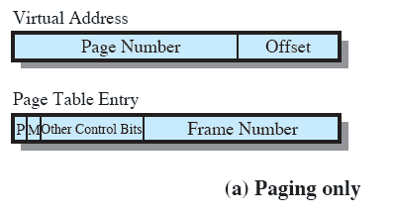
Paging Table
Notes:
This is a repeat of the notes on the previous slide
It is typical to associate a unique page table with each process. (Figure 8.2a – this slide).
A bit is needed in each page table entry to indicate whether the corresponding page is present (P) in main memory or not.
If the bit indicates that the page is in memory, then the entry also includes the frame number of that page.
The page table entry includes a modify (M) bit, indicating whether the contents of the corresponding page have been altered since the page was last loaded

Slide 12
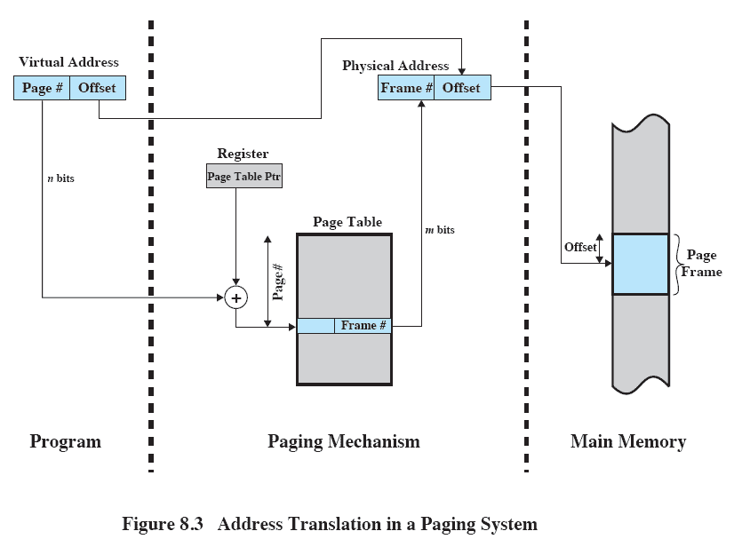
Address Translation
Notes:
The basic mechanism for reading a word from memory involves using a page table to translate a virtual/logical address,
consisting of page number and offset,
Into a physical address,
consisting of frame number and offset,
Because the page table is of variable length, depending on the size of the process, we cannot expect to hold it in registers.
Instead, it must be in main memory to be accessed.
Figure 8.3 suggests a hardware implementation.
When a particular process is running, a register holds the starting address of the page table for that process.
The page number of a virtual address is used to index that table and look up the corresponding frame number.
This is combined with the offset portion of the virtual address to produce the desired real address.
Typically, the page number field is longer than the frame number field (n > m).

Slide 13
Inverted Page Table
Used on PowerPC, UltraSPARC, and IA-64 architecture
Page number portion of a virtual address is mapped into a hash value
Hash value points to inverted page table
Notes:
The page number portion of a virtual address is mapped into a hash value using a simple hashing function.
The hash value is a pointer to the inverted page table, which contains the page table entries.
There is one entry in the inverted page table for each real memory page frame rather than one per virtual page.
Thus a fixed proportion of real memory is required for the tables regardless of the number of processes or virtual pages supported.
Because more than one virtual address may map into the same hash table entry, a chaining technique is used for managing the overflow.
The hashing technique results in chains that are typically short—between one and two entries.
The page table’s structure is called inverted because it indexes page table entries by frame number rather than by virtual page
number

Slide 14
Inverted Page Table
Each entry in the page table includes:
Page number
Process identifier
The process that owns this page.
Control bits
includes flags, such as present, modified etc
Chain pointer
the index value of the next entry in the chain.
Notes:
Page number:
This is the page number portion of the virtual address.
Process identifier:
The process that owns this page.
The combination of page number and process identifier identify a page within the virtual address space of a particular process.
Control bits:
This field includes flags, such as valid, referenced, and modified; and protection and locking information.
Chain pointer:
Contains the index value (number between 0 and 2^{m} - 1) of the next entry in the chain.
Otherwise, Null if there are no chained entries for this entry.

Slide 15
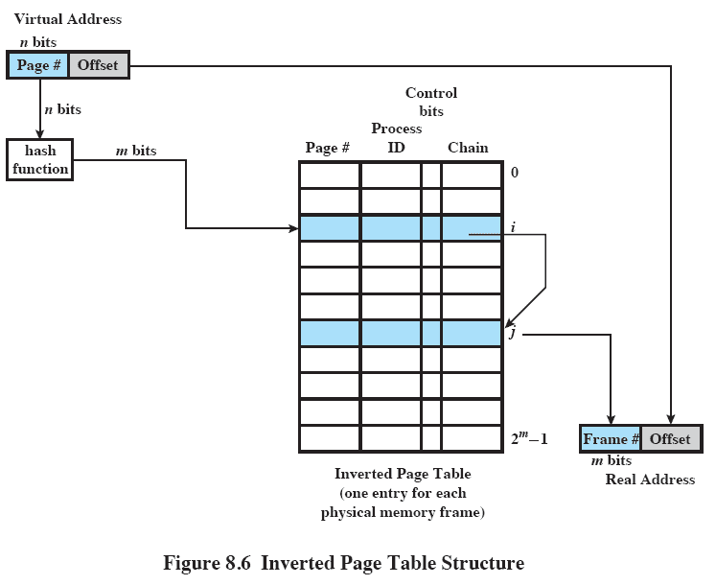
Inverted Page Table
Notes:
Refer to previous description of the fields
In this example, the virtual address includes an n-bit page number, with n > m.
The hash function maps the n-bit page number into an m-bit quantity, which is used to index into the inverted page table.

Slide 16
Translation Lookaside Buffer
Each virtual memory reference can cause two physical memory accesses
One to fetch the page table
One to fetch the data
To overcome this problem a high-speed cache is set up for page table entries
Called a Translation Lookaside Buffer (TLB)
Contains page table entries that have been most recently used
Notes:
This cache functions in the same way as a memory cache and contains those page table entries that have been most recently used.

Slide 17
TLB Operation
Given a virtual address,
processor examines the TLB
If page table entry is present (TLB hit),
the frame number is retrieved and the real address is formed
If page table entry is not found in the TLB (TLB miss),
the page number is used to index the process page table

Slide 18
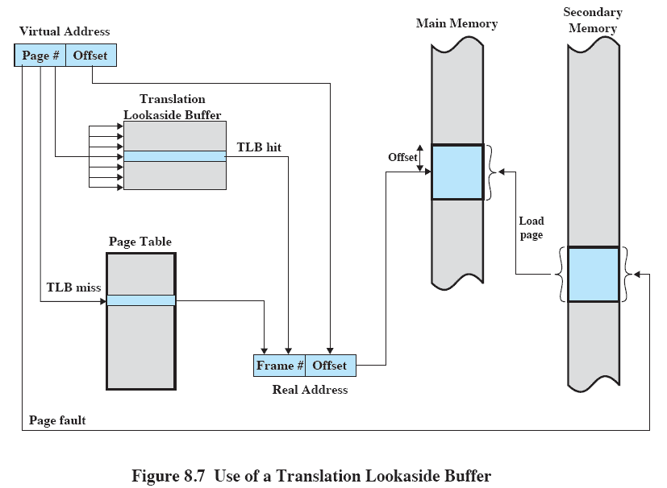
Translation Lookaside Buffer

Slide 19
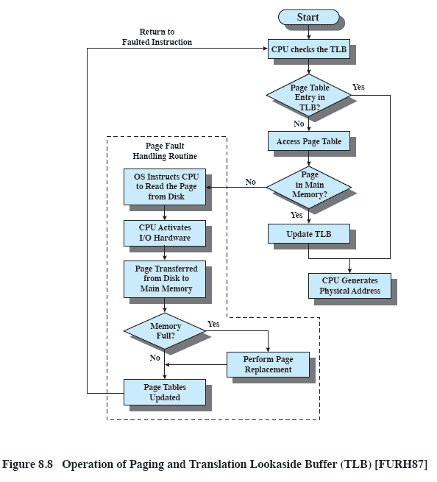
TLB operation
Notes:
The flowchart shows that if the desired page is not in main memory, a page fault interrupt causes the page fault handling routine to be invoked.
To keep the flowchart simple, the fact that the operating system may dispatch another process while disk I/O is underway is not shown.
By the principle of locality, most virtual memory references will be to locations in recently used pages. Therefore, most references will involve page table entries in the cache.

Slide 20
Associative Mapping
As the TLB only contains some of the page table entries we cannot simply index into the TLB based on the page number
Each TLB entry must include the page number as well as the complete page table entry
The process is able to simultaneously query numerous TLB entries to determine if there is a page number match
Notes:
Because the TLB only contains some of the entries in a full page table, we cannot simply index into the TLB based on page number.
Instead, each entry in the TLB must include the page number as well as the complete page table entry.
The processor is equipped with hardware that allows it to interrogate simultaneously a number of TLB entries to determine if there is a match on page number.
This technique is referred to as associative mapping.

Slide 21
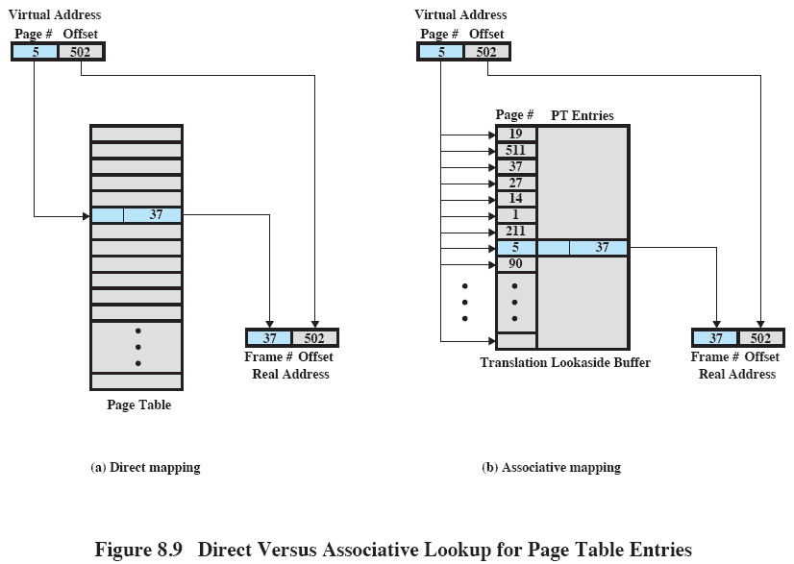
Translation Lookaside Buffer
Notes:
This slide contrasts associative mapping with direct mapping or indexing, used for lookup in the page table.
The design of the TLB also must consider the way in which entries are organized in the TLB and which entry to replace when a new entry is brought in.
These issues must be considered in any hardware cache design.

Slide 22
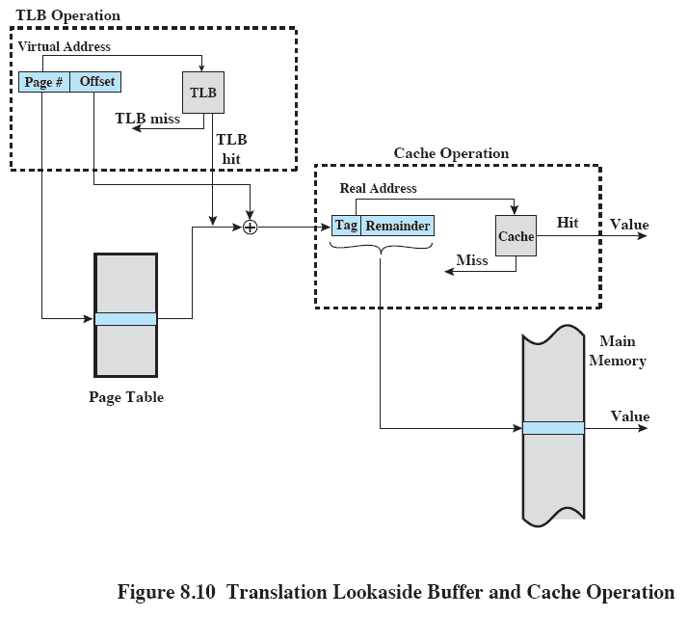
TLB and Cache Operation
Notes:
The virtual memory mechanism must interact with the cache system (not the TLB cache, but the main memory cache)
A virtual address will generally be in the form of a page number, offset.
First, the memory system consults the TLB to see if the matching page table entry is present.
If it is, the real (physical) address is generated by combining the frame number with the offset.
If not, the entry is accessed from a page table.
Once the real address is generated, which is in the form of a tag and a remainder, the cache is consulted to see if the block containing that word is present.
If so, it is returned to the CPU.
If not, the word is retrieved from main memory.

Slide 23
Page Size
Smaller page size, less amount of internal fragmentation
But Smaller page size, more pages required per process
More pages per process means larger page tables
Larger page tables means large portion of page tables in virtual memory
Notes:
An important hardware design decision is the size of page to be used.
There are several factors to consider.
internal fragmentation. Clearly, the smaller the page size, the less the amount of internal fragmentation. To optimize the use of main memory, we would like to reduce internal fragmentation.
BUT the smaller the page, the greater the number of pages required per process. More pages per process means larger page tables. For large programs in a heavily multiprogrammed environment, this may mean that some portion of the page tables of active processes must be in virtual memory, not in main memory.
The physical characteristics of most secondary-memory devices, which are rotational, favour a larger page size for more efficient block transfer of data

Slide 24
Page Size
Secondary memory is designed to efficiently transfer large blocks of data so a large page size is better

Slide 25
Segmentation
Segmentation allows the programmer to view memory as consisting of multiple address spaces or segments.
May be unequal, dynamic size
Allows programs to be altered and recompiled independently
Lends itself to sharing data among processes
Lends itself to protection
Notes:
Segmentation allows the programmer to view memory as consisting of multiple address spaces or segments.
Segments may be of unequal, indeed dynamic, size.
Memory references consist of a form of address (segment number, offset).
This organization has a number of advantages to the programmer over a nonsegmented address space:
It simplifies the handling of growing data structures.
If the programmer doesn’t know ahead of time how large a particular data structure will become, it is necessary to guess unless dynamic segment sizes are allowed. With segmented virtual memory, the data structure can be assigned its own segment, and the operating system will expand or shrink the segment as needed.
If a segment that needs to be expanded is in main memory and there is insufficient room, the operating system may move the segment to a larger area of main memory, if available, or swap it out. The enlarged segment would be swapped back in at the next opportunity.
2. It allows programs to be altered and recompiled independently,
without requiring the entire set of programs to be relinked and reloaded.
Again, this is accomplished using multiple segments.
3. It lends itself to sharing among processes.
A programmer can place a utility program or a useful table of data in a segment that can be referenced by other processes.
4. It lends itself to protection.
Because a segment can be constructed to contain a well-defined set of programs or data, the programmer or system administrator can assign access privileges in a convenient fashion.

Slide 26
Segment Organization
Contain Starting address of corresponding segment in main memory
Each entry contains the length of the segment
A bit is needed to determine if segment is already in main memory
Another bit is needed to determine if the segment has been modified since it was loaded in main memory
Notes:
Each segment table entry contains the starting address of the corresponding segment in main memory, as well as the length of the segment.
The same device, a segment table, is needed when we consider a virtual memory scheme based on segmentation.
Again, it is typical to associate a unique segment table with each process.
But because only some of the segments of a process may be in main memory, a bit is needed in each segment table entry to indicate whether the corresponding segment is present in main memory or not.
If the bit indicates that the segment is in memory, then the entry also includes the starting address and length of that segment.
Another control bit in the segmentation table entry is a modify bit, indicating whether the contents of the corresponding segment have been altered since the segment was last loaded into main memory.
If there has been no change, then it is not necessary to write the segment out when it comes time to replace the segment in the frame that it currently occupies.
Other control bits may also be present.

Slide 27
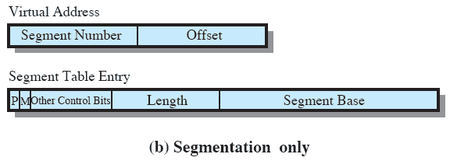
Segment Table Entries

Slide 28
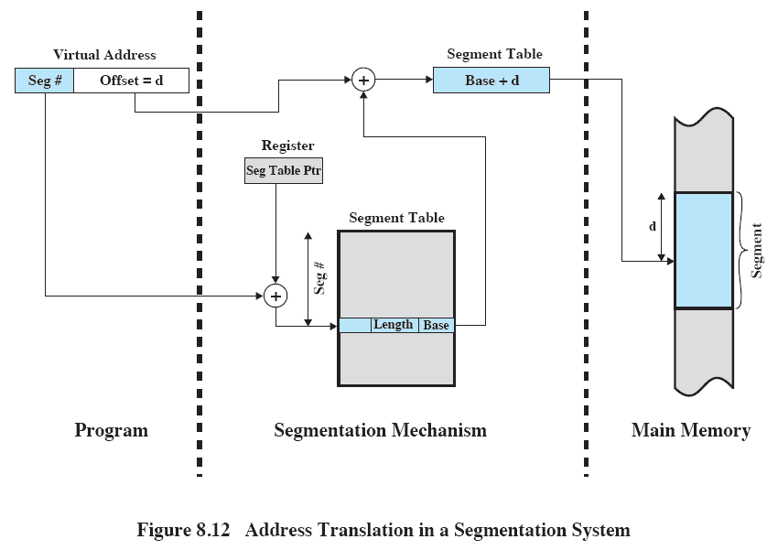
Address Translation in Segmentation
Notes:
Reading a word from memory involves the translation of a virtual, or logical, address, consisting of segment number and offset, into a physical address, using a segment table.
We cannot expect to hold the segment table in registers because it is of variable length, depending on the size of the process
Instead, it must be in main memory to be accessed.
This figure suggests a hardware implementation of this scheme (note similarity to Figure 8.3).
When a particular process is running, a register holds the starting address of the segment table for that process.
The segment number of a virtual address is used to index that table and look up the corresponding main memory address for the start of the segment.
This is added to the offset portion of the virtual address to produce the desired real address.

Slide 29
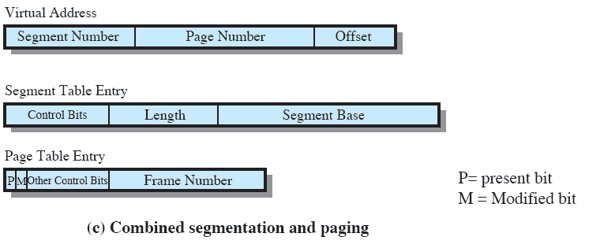
Combined Paging and Segmentation
Notes:
This figure (8.2c) suggests the segment table entry and page table entry formats.
As before, the segment table entry contains the length of the segment.
It also contains a base field, which now refers to a page table.
The present and modified bits are not needed because these matters are handled at the page level.
Other control bits may be used, for purposes of sharing and protection.
The page table entry is essentially the same as is used in a pure paging system.
Each page number is mapped into a corresponding frame number if the page is present in main memory.
The modified bit indicates whether this page needs to be written back out when the frame is allocated to another page.
There may be other control bits dealing with protection or other aspects of memory management.

Slide 30
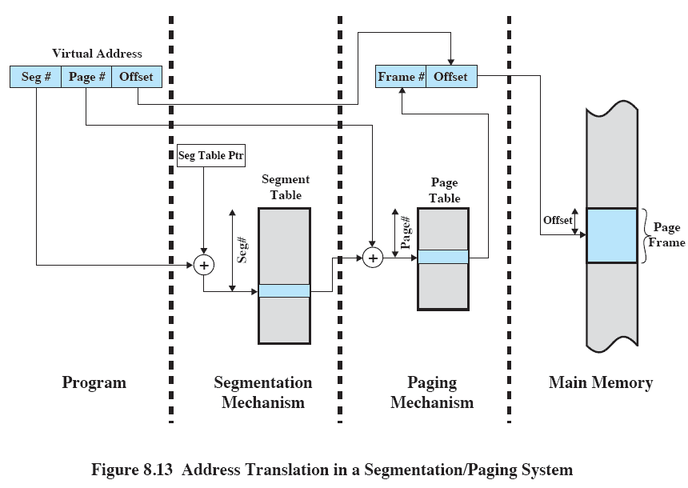
Address Translation
Notes:
This figure suggests a structure to support combined paging/segmentation (note similarity to Figure 8.5).
Associated with each process is a segment table and a number of page tables, one per process segment.
When a particular process is running, a register holds the starting address of the segment table for that process.
Presented with a virtual address, the processor uses the segment number portion to index into the process segment table to find the page table for that segment.
Then the page number portion of the virtual address is used to index the page table and look up the corresponding frame number.
This is combined with the offset portion of the virtual address to produce the desired real address.

Slide 31
Protection and sharing
Segmentation lends itself to the implementation of protection and sharing policies.
As each entry has a base address and length, memory access can be controlled
Sharing can be achieved by segments referencing multiple processes
Notes:
Segmentation lends itself to the implementation of protection and sharing policies.
As each segment table entry includes a length as well as a base address, a program cannot inadvertently access a main memory location beyond the limits of a segment.
To achieve sharing, it is possible for a segment to be referenced in the segment tables of more than one process.

Slide 32
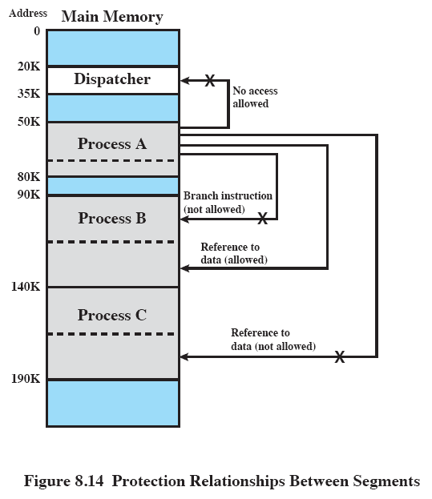
Protection Relationships
Notes:
Figure 8.14 illustrates the types of protection relationships that can be enforced in such a system.

Slide 33
8.2 OPERATING SYSTEM SOFTWARE
The design of the memory management depends on three fundamental areas of choice:
Whether or not to use virtual memory techniques
The use of paging or segmentation or both
The algorithms employed for various aspects of memory management

Slide 34
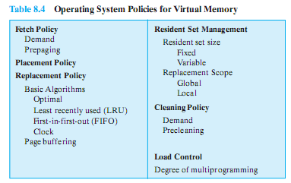
Key Design Elements
Key aim: Minimise page faults
Notes:
We would like to minimize the rate at which page faults occur, because page faults cause considerable software overhead.
At a minimum, the overhead includes deciding which resident page or pages to replace,
and the I/O of exchanging pages.
Also, the operating system must schedule another process to run during the page I/O, causing a process switch.
In all of the areas referred to in Table 8.4, there is no definitive policy that works best.
The performance of any particular set of policies depends on
main memory size,
the relative speed of main and secondary memory,
the size and number of processes competing for resources,
and the execution behaviour of individual programs.

Slide 35
Fetch Policy
Determines when a page should be brought into memory
Two main types:
Demand Paging
Prepaging
Notes:
The fetch policy determines when a page should be brought into main memory.
The two common alternatives are demand paging and prepaging

Slide 36
Placement Policy
Determines where in real memory a process piece is to reside
policies such as best-fit, first-fit
Notes:
The placement policy determines where in real memory a process piece is to reside.
In a pure segmentation system, the placement policy is an important design issue;
policies such as best-fit, first-fit, and etc are possible alternatives.
However, for a system that uses either pure paging or paging combined with segmentation,
placement is usually irrelevant because the address translation hardware and the main memory access hardware can perform their functions for any page-frame combination with equal efficiency.

Slide 37
Replacement Policy
When all of the frames in main memory are occupied and it is necessary to bring in a new page, the replacement policy determines which page currently in memory is to be replaced.
Notes:
This topic is sometimes difficult to explain because several interrelated concepts are involved:
• How many page frames are to be allocated to each active process
• Whether the set of pages to be considered for replacement should be limited to those of the process that caused the page fault or encompass all the page frames in main memory
• Among the set of pages considered, which particular page should be selected for replacement
When all of the frames in main memory are occupied and it is necessary to bring in a new page to satisfy a page fault,
the replacement policy determines which page currently in memory is to be replaced.

Slide 38
But…
Which page is replaced?
Page removed should be the page least likely to be referenced in the near future
How is that determined?
Most policies predict the future behavior on the basis of past behavior
Notes:
One tradeoff that must be considered is that the more elaborate and sophisticated the replacement policy, the greater the hardware and software overhead to implement it

Slide 39
Replacement Policy: Frame Locking
Frame Locking
If frame is locked, it may not be replaced
Kernel of the operating system
Key control structures
I/O buffers
Associate a lock bit with each frame
Notes:
Camera jumps to animation of Page Replacement Algorithm http://gaia.ecs.csus.edu/~zhangd/oscal/PagingApplet.html
One restriction on replacement policy needs to be mentioned before looking at various algorithms:
Some of the frames in main memory may be locked.
When a frame is locked, the page currently stored in that frame may not be replaced.
Much of the kernel of the operating system is held on locked frames, as well as key control structures.
In addition, I/O buffers and other time-critical areas may be locked into main memory frames.
Locking is achieved by associating a lock bit with each frame.
This bit may be kept in a frame table as well as being included in the current page table.

Slide 40
Basic Replacement Algorithms
There are certain basic algorithms that are used for the selection of a page to replace, they include
Optimal
Least recently used (LRU)
First-in-first-out (FIFO)
Clock

Slide 41
Examples
An example of the implementation of these policies will use a page address stream formed by executing the program is
2 3 2 1 5 2 4 5 3 2 5 2
Which means that the first page referenced is 2,
the second page referenced is 3,
And so on.
Notes:
Figure 8.15 gives an example of the optimal policy. The example assumes a
fixed frame allocation (fixed resident set size) for this process of three frames. The
execution of the process requires reference to five distinct pages. The page address
stream formed by executing the program is
232152453252
which means that the first page referenced is 2, the second page referenced is 3, and
so on. The optimal policy produces three page faults after the frame allocation has
been filled.

Slide 42
Optimal policy
Selects for replacement that page for which the time to the next reference is the longest
But Impossible to have perfect knowledge of future events
Notes:
The optimal policy selects for replacement that page for which the time to the next reference is the longest.
This policy results in the fewest number of page faults.
BUT Clearly, this policy is impossible to implement, because it would require the operating system to have perfect knowledge of future events.
However, it does serve as a standard against which to judge real world algorithms.

Slide 43
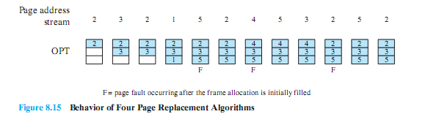
Optimal Policy Example
The optimal policy produces three page faults after the frame allocation has been filled.

Slide 44
Least Recently Used (LRU)
Replaces the page that has not been referenced for the longest time
Notes:
The least recently used (LRU) policy replaces the page in memory that has not been referenced for the longest time.
By the principle of locality, this should be the page least likely to be referenced in the near future.
And, in fact, the LRU policy does nearly as well as the optimal policy.
The problem with this approach is the difficulty in implementation.
One approach would be to tag each page with the time of its last reference;
this would have to be done at each memory reference, both instruction and data.
Even if the hardware would support such a scheme, the overhead would be tremendous.
Alternatively, one could maintain a stack of page references, again an expensive prospect.

Slide 45
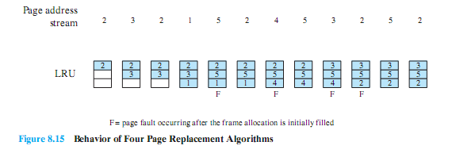
LRU Example
The LRU policy does nearly as well as the optimal policy.
In this example, there are four page faults

Slide 46
First-in, first-out (FIFO)
Page that has been in memory the longest is replaced
Notes:
The first-in-first-out (FIFO) policy treats the page frames allocated to a process as a circular buffer, and pages are removed in round-robin style.
All that is required is a pointer that circles through the page frames of the process.
This is one of the simplest page replacement policies to implement.
The logic behind this choice is that one is replacing the page that has been in memory the longest:
A page fetched into memory a long time ago may have now fallen out of use.
This reasoning will often be wrong, because there will often be regions of program or data that are heavily used throughout the life of a program.
Those pages will be repeatedly paged in and out by the FIFO algorithm.

Slide 47
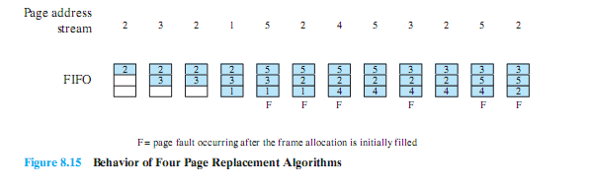
FIFO Example
The FIFO policy results in six page faults.
Notes:
Continuing our example in Figure 8.15, the FIFO policy results in six page faults.
Note that LRU recognizes that pages 2 and 5 are referenced more frequently than other pages, whereas FIFO does not.
Although the LRU policy does nearly as well as an optimal policy, it is difficult to implement and imposes significant overhead.
On the other hand, the FIFO policy is very simple to implement but performs relatively poorly.
Over the years, operating system designers have tried a number of other algorithms to approximate the performance of LRU while imposing little overhead.

Slide 48
Clock Policy
Uses and additional bit called a “use bit”
When a page is first loaded in memory or referenced, the use bit is set to 1
When it is time to replace a page, the OS scans the set flipping all 1’s to 0
The first frame encountered with the use bit already set to 0 is replaced.
Notes:
Camera jumps to animation of clock policy at http://gaia.ecs.csus.edu/~zhangd/oscal/ClockFiles/Clock.htm
The simplest form of clock policy requires the association of an additional bit with each frame, referred to as the use bit.
When a page is first loaded into a frame in memory, the use bit for that frame is set to 1.
Whenever the page is subsequently referenced (after the reference that generated the page fault), its use bit is set to 1.
The set of frames that are candidates for replacement is considered to be a circular buffer, with which a pointer is associated.
When a page is replaced, the pointer is set to indicate the next frame in the buffer after the one just updated.
When it comes time to replace a page, the operating system scans the buffer to find a frame with a use bit set to zero.
Each time it encounters a frame with a use bit of 1, it resets that bit to zero and continues on.
If any of the frames in the buffer have a use bit of zero at the beginning of this process, the first such frame encountered is chosen for replacement.
If all of the frames have a use bit of 1, then the pointer will make one complete cycle through the buffer, setting all the use bits to zero, and stop at its original position, replacing the page in that frame.
This policy is similar to FIFO, except that, in the clock policy, any frame with a use bit of 1 is passed over by the algorithm.

Slide 49
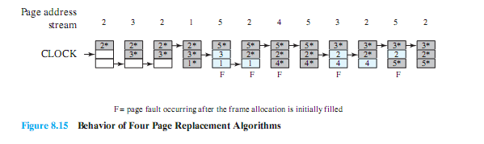
Clock Policy Example
Notes:
The presence of an asterisk indicates that the corresponding use bit is equal to 1,
and the arrow indicates the current position of the pointer.
Note that the clock policy is adept at protecting frames 2 and 5 from replacement.

Slide 50
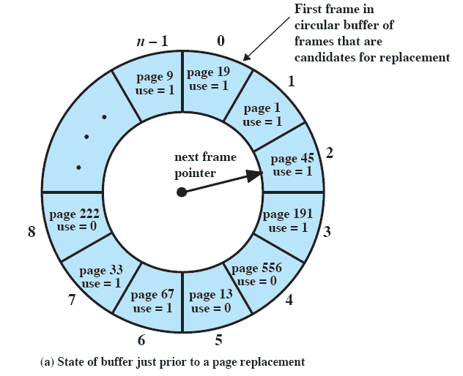
Clock Policy
Notes:
Continued on next slide
This figure (8.16) provides an example of the simple clock policy mechanism.
A circular buffer of n main memory frames is available for page replacement.
Just prior to the replacement of a page from the buffer with incoming page 727,
the next frame pointer points at frame 2, which contains page 45.
The clock policy is now executed.
Because the use bit for page 45 in frame 2 is equal to 1, this page is not replaced.
Instead, the use bit is set to zero and the pointer advances.
Similarly, page 191 in frame 3 is not replaced; its use bit is set to zero and the pointer advances.
In the next frame, frame 4, the use bit is set to 0.Therefore, page 556 is replaced with page 727.
The use bit is set to 1 for this frame and the pointer advances to frame 5, completing the page replacement procedure.

Slide 51
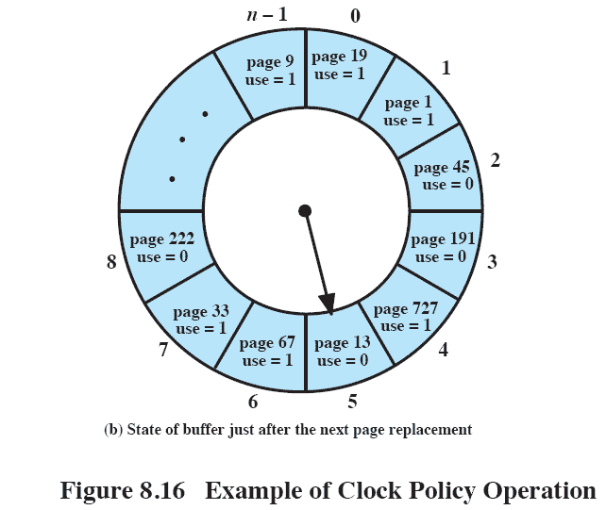
Clock Policy
Notes:
Explanation on previous slide

Slide 52
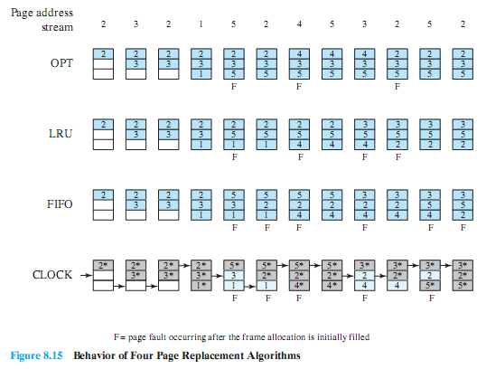
Combined Examples

Slide 53
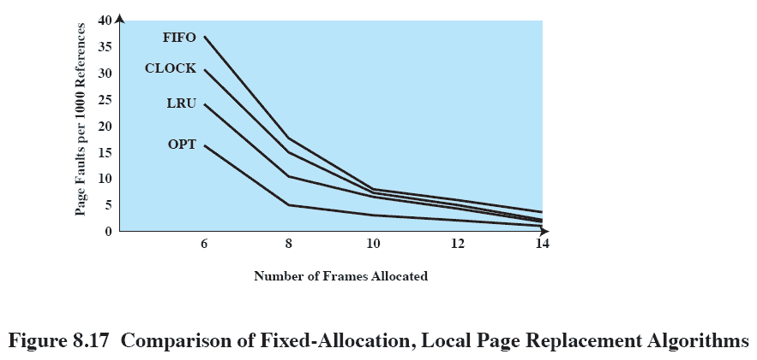
Comparison
Notes:
Figure 8.17 shows the results of an experiment reported in, which compares the four algorithms that we have been discussing;
It is assumed that the number of page frames assigned to a process is fixed.
The results are based on the execution of 0.25 x 10⁶ references in a FORTRAN program, using a page size of 256 words.
Baer ran the experiment with frame allocations of 6, 8, 10, 12, and 14 frames.
The differences among the four policies are most striking at small allocations, with FIFO being over a factor of 2 worse than optimal.
All four curves have the same shape as the idealized behavior shown in Figure 8.11b.
In order to run efficiently, we would like to be to the right of the knee of the curve (with a small page fault rate) while at the same time keeping a
small frame allocation (to the left of the knee of the curve).
These two constraints indicate that a desirable mode of operation would be at the knee of the curve.

Slide 54
Resident Set Management
The OS must decide how many pages to bring into main memory
The smaller the amount of memory allocated to each process, the more processes that can reside in memory.
Small number of pages loaded increases page faults.
Notes:
With paged virtual memory, it is not necessary and indeed may not be possible to bring all of the pages of a process into main memory to prepare it for execution.
Thus, the operating system must decide how many pages to bring in
IE , how much main memory to allocate to a particular process.
Several factors come into play:
• The smaller the amount of memory allocated to a process, the more processes that can reside in main memory at any one time. This increases the probability that the operating system will find at least one ready process at any given time and hence reduces the time lost due to swapping.
• If a relatively small number of pages of a process are in main memory, then, despite the principle of locality, the rate of page faults will be rather high
• Beyond a certain size, additional allocation of main memory to a particular process will have no noticeable effect on the page fault rate for that process because of the principle of locality.

Slide 55
Resident Set Size
Fixed-allocation
Gives a process a fixed number of pages within which to execute
When a page fault occurs, one of the pages of that process must be replaced
Variable-allocation
Number of pages allocated to a process varies over the lifetime of the process
Notes:
A fixed-allocation policy gives a process a fixed number of frames in main memory within which to execute.
That number is decided at initial load time (process creation time) and may be determined based on the type of process (interactive, batch, type of application) or may be based on guidance from the programmer or system manager.
Whenever a page fault occurs in the execution of a process, one of the pages of that process must be replaced by the needed page.
A variable-allocation policy allows the number of page frames allocated to a process to be varied over the lifetime of the process.
Ideally, a process that is suffering persistently high levels of page faults, indicating that the principle of locality only holds in a weak form for that process, will be given additional page frames to reduce the page fault rate;
whereas a process with an exceptionally low page fault rate will be given a reduced allocation, with the hope that this will not noticeably increase the page fault rate.
The use of a variable-allocation policy relates to the concept of replacement scope

Slide 56
Replacement Scope
The scope of a replacement strategy can be categorized as global or local.
Both types are activated by a page fault when there are no free page frames.
A local replacement policy chooses only among the resident pages of the process that generated the page fault
A global replacement policy considers all unlocked pages in main memory
Notes:
The scope of a replacement strategy can be categorized as global or local.
Both types of policies are activated by a page fault when there are no free page frames.
A local replacement policy chooses only among the resident pages of the process that generated the page fault in selecting a page to replace.
A global replacement policy considers all unlocked pages in main memory as candidates for replacement, regardless of which process owns a particular page.

Slide 57
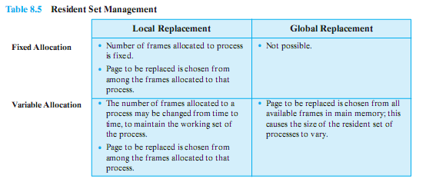
Resident Set Management Summary

Slide 58
Cleaning Policy
A cleaning policy is concerned with determining when a modified page should be written out to secondary memory.
Demand cleaning
A page is written out only when it has been selected for replacement
Precleaning
modified pages before their page frames are needed
Notes:
A cleaning policy is the opposite of a fetch policy; it is concerned with determining when a modified page should be written out to secondary memory.
With demand cleaning, a page is written out to secondary memory only when it has been selected for replacement.
A precleaning policy writes modified pages before their page frames are needed so that pages can be written out in batches.

Slide 59
Load Control
Determines the number of processes that will be resident in main memory
Too few processes, many occasions when all processes will be blocked and much time will be spent in swapping
Too many processes will lead to thrashing
Notes:
Load control is concerned with determining the number of processes that will be resident in main memory - the multiprogramming level.
The load control policy is critical in effective memory management.
If too few processes are resident at any one time, then there will be many occasions when all processes are blocked, and much time will be spent in swapping.
On the other hand, if too many processes are resident, then, on average, the size of the resident set of each process will be inadequate and frequent faulting will occur resulting in thrashing.

Slide 60
Process Suspension
if one or more of the currently resident processes must be suspended (swapped out).
Six possibilities exist…
Notes:
If the degree of multiprogramming is to be reduced, one
or more of the currently resident processes must be suspended (swapped out).
[CARR84] lists six possibilities:

Slide 61
Suspension policies
Lowest priority process
Faulting process
Last process activated
Process with smallest resident set
Largest process
Process with the largest remaining execution window
Notes:
Lowest-priority process:
This implements a scheduling policy decision and is unrelated to performance issues.
Faulting process:
There is a greater probability that the faulting task does not have its working set resident, and performance would suffer least by suspending it.
Immediate payoff because it blocks a process that is about to be blocked anyway and it eliminates the overhead of a page replacement and I/O operation.
Last process activated:
This is the process least likely to have its working set resident.

